Slide 1

Dragon Running Game
Prepared by:-
Ashutosh kumar

Slide 2

Actual meaning of game
A game is a structured form of play, usually undertaken for entertainment or fun, and sometimes used as an educational tool. Many games are also considered to be work or art. Games are sometimes played purely for enjoyment, sometimes for achievement or reward as well.

Slide 3

Positive effects of gaming include:
Improved cognitive abilities
Improved problem-solving skills and logic
Increased hand-to-eye coordination
Greater multi-tasking ability
Faster and more accurate decision-making
Enhanced prosocial behaviors
Better eyesight (attention to detail)
More physical activity with games that promote physical activity (VR, mobile games)
And other benefits.

Slide 4
There are some cons of video games
Video games can make you addicted
Elevated risk of aggression
Games replace real-world problems
Some games promote gambling
Decreased physical and mental health
Lack of focus and concentration

Slide 5
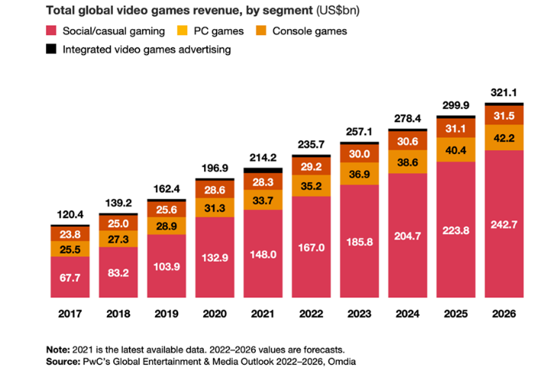
Uses of video games in the whole world:-

Slide 6
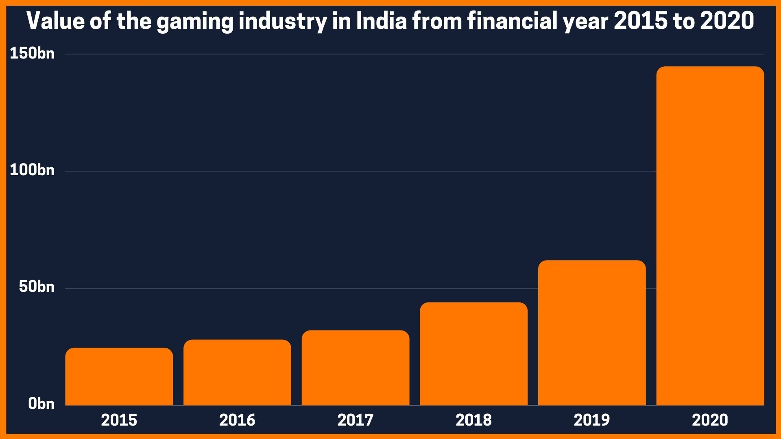
Uses of video game in India:-

Slide 7
HTML,CSS & JS
HTML provides the basic structure of sites, which is enhanced and modified by other technologies like CSS and JavaScript.
CSS is used to control presentation, formatting, and layout.
JavaScript is used to control the behavior of different elements.

Slide 8
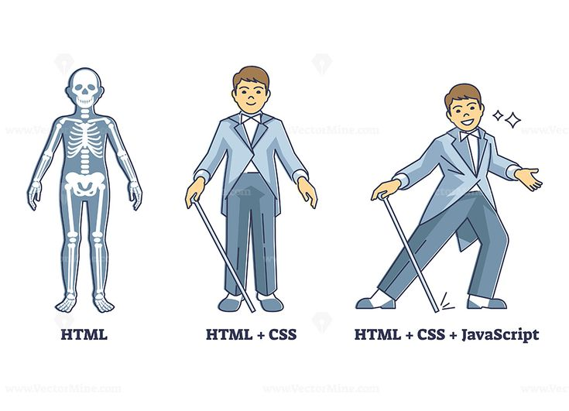
HTML VS CSS VS JS

Slide 9
Difference b/w HTML V/S CSS
S.NO. | HTML | CSS
1. | HTML is a markup language used to define a structure of a web page. | CSS is a style sheet language used to style the web pages by using different styling features.
2. | It consists of tags inside which text is enclosed. | It consists of selectors and declaration blocks.
3. | HTML doesn’t have further types. | CSS can be internal or external depending upon the requirement.
4. | We cannot use HTML inside a CSS sheet. | We can use CSS inside an HTML document.
5. | HTML is not used for presentation and visualization. | CSS is used for presentation and visualization.
6. | HTML has comparatively less backup and support. | CSS has comparatively higher backup and support.
7. | HTML doesn’t allow animations and transitions. | CSS allows animation and transitions which helps to improve the UI.
8. | HTML files are saved with .htm or .html extension. | CSS files are saved with .css extension.
Difference between HTML and CSS:

Slide 10
Difference b/w CSS V/S JS
CSS | Javascript
CSS stylizes components of the webpage. | JavaScript is dependable for the interactivity of the webpage.
CSS is much easier and more basic when it comes to web page formatting and designing. | JavaScript is tougher compare to CSS in this scenario.
CSS directly defines in the <style> tag in HTML. | The <script> tag should be used for JavaScript code.
CSS can not approve shapes, can be utilized to identify guest browsers, and can be utilized to recover and store data from visitors’ computers. | JavaScript can approve shapes, can be utilized to identify guest browsers, and can be utilized to recover and store data from visitors’ computers.
Any broken CSS rule will not impact your entire web-app and would not stop the site from loading. | An error in your JavaScript code will breakdown the complete app.
CSS is applied to both HTML and XML. | JavaScript is applied on HTML only.
There is more scope for Optimization in the case of CSS. | JavaScript does not support these types of optimizations because it does not have access to those APIs.
CSS files are saved with .CSS extension. | JavaScript files are saved with an extension .js

Slide 11


